Slide 1



Internship Report
Profit Prediction
Based on its R&D Spend, Administration Cost, and Marketing Spend

Slide 2


Introduction
The introduction provides an overview of the project's objective, explaining the significance of predicting company profits and the potential benefits it can offer to businesses. It highlights the importance of accurate profit prediction for financial planning, budgeting, and investment decisions.
Additionally, the introduction briefly describes the dataset used, the target variable for prediction, and the variables considered as predictors.
Profit prediction plays a crucial role in the business world, enabling organizations to make informed decisions, devise effective strategies, and allocate resources wisely. Accurate profit forecasting provides valuable insights for financial planning, budgeting, and investment decisions, leading to enhanced overall performance and sustainable growth.

Slide 3
Objective
The aim of this project is to develop a machine learning model that predicts the profit value of a company based on its R&D Spend, Administration Cost, and Marketing Spend. The accurate prediction of profits can help businesses make informed decisions, optimize resource allocation, and enhance overall performance.
In this report, we explore different regression algorithms, perform data preprocessing, train the models, evaluate their performance, and choose the best model for profit prediction.
The report covers the entire process from data preparation to model implementation and concludes with the results and findings.

Slide 4

Dataset
The 4 attributes in the dataset provided are:
R&D Spend: This attribute represents the total expenditure made by each company on research and development activities. R&D investment is a crucial factor for a company's growth and innovation, and it directly impacts its potential for generating profits.
Marketing Spend: The Marketing Spend attribute denotes the amount allocated by each company towards marketing and advertising campaigns. Effective marketing strategies can significantly influence a company's brand visibility, customer acquisition, and overall revenue generation.
Administration: This attribute reflects the administrative expenses incurred by each company, covering essential functions such as personnel, office operations, and other administrative costs. Proper management of administration costs is vital for optimizing operational efficiency and, consequently, profitability.

Slide 5
Dataset
Profit: The Profit attribute serves as the target variable in the dataset, representing the net profit earned by each company during a specific time period. It takes into account all revenue streams and expenses, providing an overall measure of a company's financial performance.

Slide 6
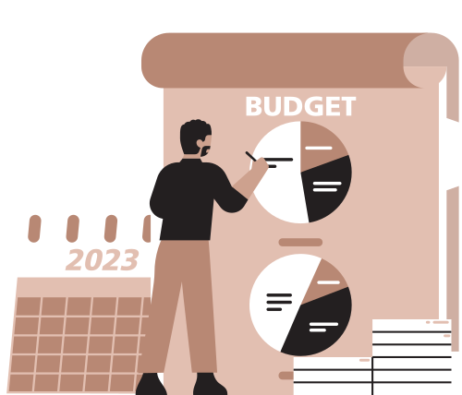
Model Selection
In this analysis, we will explore the suitability of three popular algorithms: Linear Regression, Decision Tree, and Random Forest for predicting profit using the Company Financial Dataset.
1. Linear Regression: A supervised learning algorithm, it is well-suited for predicting continuous target variables, making it an attractive choice for our profit prediction problem. Linear Regression assumes a linear relationship between the predictors (R&D Spend, Marketing Spend, and Administration) and the target variable (Profit). It estimates the coefficients for each predictor to best fit a straight line to the data.
Advantages:
Simplicity: Linear Regression is straightforward and easy to interpret, making it an ideal choice for initial modeling and gaining insights into the data.
Speed: Training and making predictions with Linear Regression is computationally efficient, making it suitable for large datasets.

Slide 7
Model Selection
2. Decision Tree: Decision Trees are non-linear models that recursively partition the data based on the predictors' values to make predictions. They create a tree-like structure where each internal node represents a decision based on a predictor, and each leaf node corresponds to the predicted value (Profit) for a given set of attributes.
Advantages:
Non-linearity: Decision Trees can capture non-linear relationships in the data, making them more flexible than Linear Regression.
Interpretability: Decision Trees are easy to understand and visualize, aiding in gaining insights into the decision-making process.

Slide 8
Model Selection
3. Random Forest: Random Forest is an ensemble learning method that combines multiple Decision Trees to improve prediction accuracy and reduce overfitting. It builds multiple trees using bootstrapped subsets of the data and randomly selected subsets of predictors.
Advantages:
High Accuracy: Random Forest tends to have higher accuracy compared to individual Decision Trees due to the averaging effect of multiple trees.
Robustness: Random Forest reduces the risk of overfitting and performs well on various types of data.

Slide 9
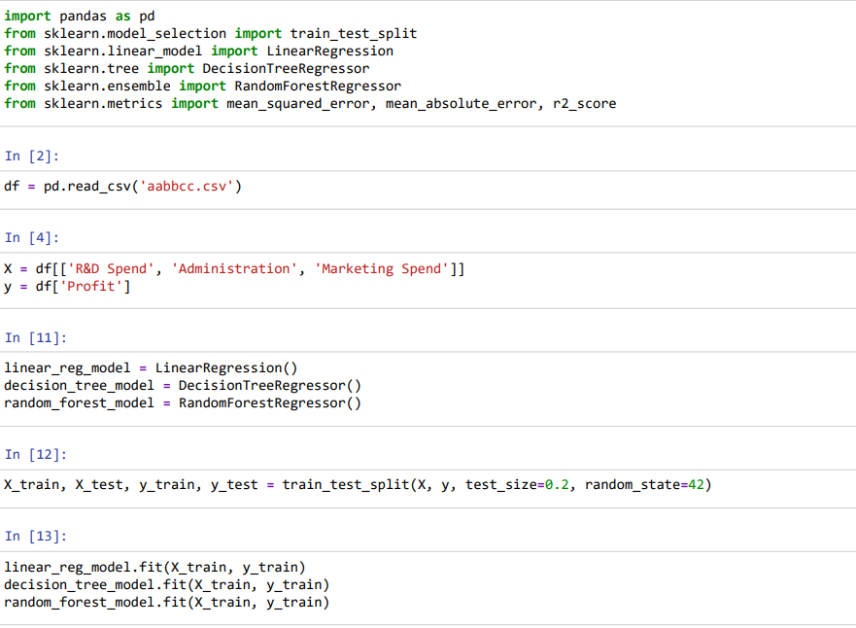
Model Training and Evaluation
To train and evaluate the models, we need to split the dataset into two parts: the training set and the test set. The train_test_split function from Scikit-learn is used for this purpose. The training set will be used to train the models, while the test set will be used to evaluate their performance.
After training the models, we can evaluate their performance using various metrics such as Mean Squared Error (MSE), Mean Absolute Error (MAE), and R-squared (R2). Scikit-learn provides functions to calculate these metrics.

Slide 10
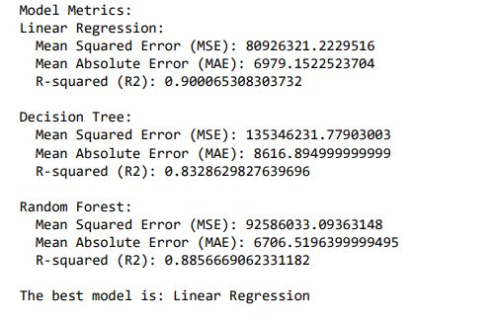
Results
The computed evaluation metrics (linear_mse, linear_mae, linear_r2, tree_mse, tree_mae, tree_r2, forest_mse, forest_mae, forest_r2) will provide insights into how well each model performs in predicting profit values. Lower values of MSE and MAE indicate better model performance, while R2 close to 1 indicates a good fit.
After evaluating results, Linear Regression is chosen as the best model as it has the lowest values of MSE and MAE and R2 value is closest to 1.

Slide 11

Conclusion
In conclusion, the development and evaluation of machine learning models for profit prediction based on R&D Spend, Marketing Spend, and Administration cost have shown promising results.
We explored three popular algorithms: Linear Regression, Decision Tree, and Random Forest and found that each algorithm has its strengths and weaknesses.
Linear Regression provides simplicity and interpretability, making it suitable for initial insights into the data.
Decision Trees can capture non-linear relationships, while Random Forest combines multiple trees to improve prediction accuracy and robustness.
Accurate profit predictions can assist business leaders and stakeholders in making informed decisions related to resource allocation, investment strategies, and long-term planning.

Slide 12
Thank you

